Slide 1
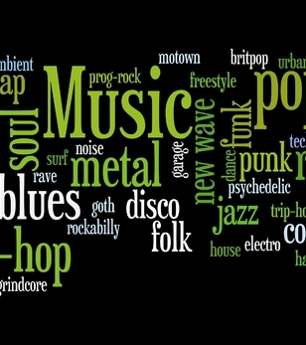

M.U.G.G.E. Mostly Unfinished Genre Grading Engine
As a project of the class Machine Learning at the University of Hamburg

Slide 2
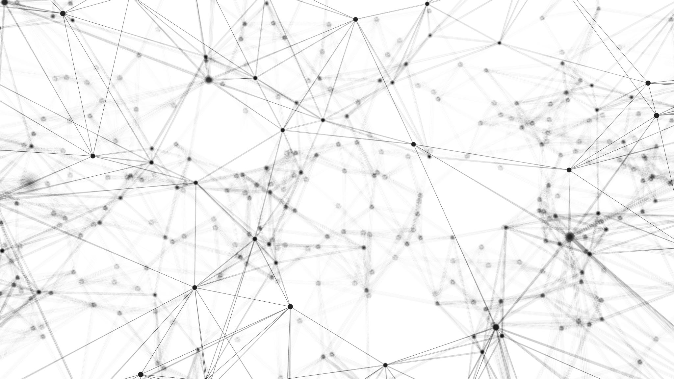
Goals
Build a high performance model for basic learners
Use a balanced medium size dataset to classify 10 genres
Investigate different classifiers finding the most efficient one for classifying our genres
High performance predictions recording new input
Build a model capable of efficient predictions given new input
Build a GUI

Slide 3
Music Genres
Blues
Classical
Country
Disco
Hip Hop
Jazz
Metal
Pop
Reggae
Rock

Slide 4
Dataset
1000 songs
100 songs for each genre
Audio duration: 30 seconds
Source of dataset: Kaggle.com, GTZAN Dataset-Music Genre Classification

Slide 5
Features
Zero Crossing rate
Spectral Centroid
Mel-Frequency Cepstral Coefficients
Chroma Frequencies
Chords

Slide 6
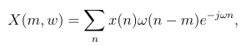
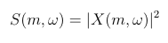
Short-Time Fourier Transform
Music signals are highly non-stationary, i.e., their statistics change over time.
Meaningless to compute a single FT over an entire song
The STFT is obtained by computing the Fourier transform for successive frames in a signal:
with time m and frequency ω
Since we care about the spectral magnitude and not the phase content, we use the spectrogram, which shows the intensity of frequencies over time.
A Spectogram is simply the squared magnitude of the STFT:

Slide 7
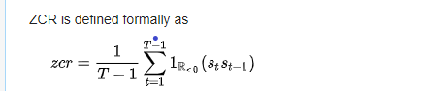
Zero Crossing Rate
The number of times the amplitude of the signal passes through a value of zero, within a time interval.
Measure of smoothness of an audio signal
Higher values for highly percussive sounds like those in metal and pop.
where s: signal of length T

Slide 8
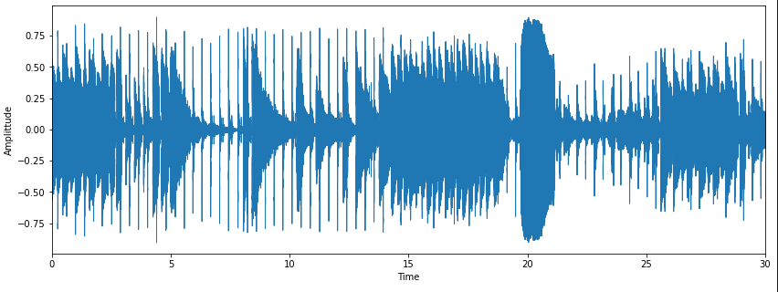
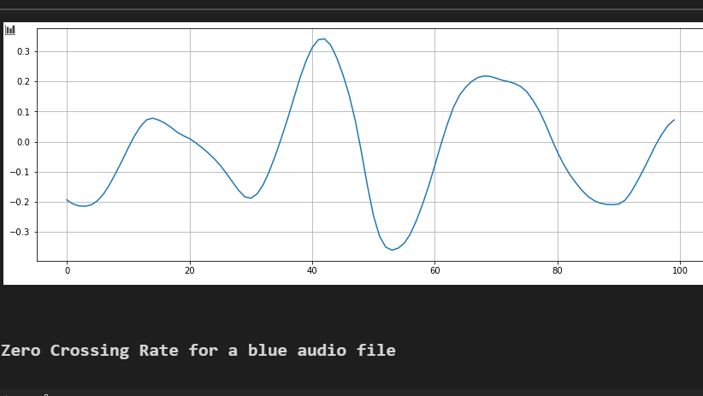
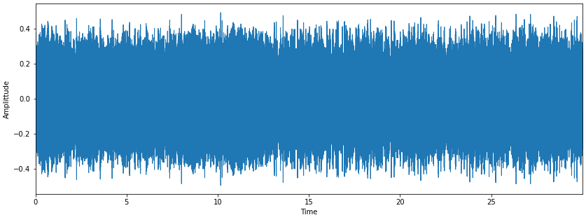
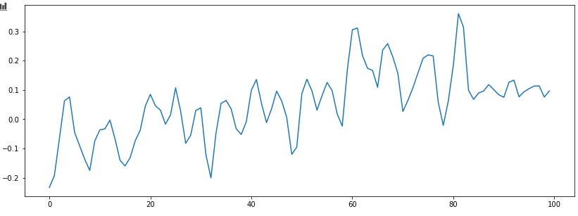
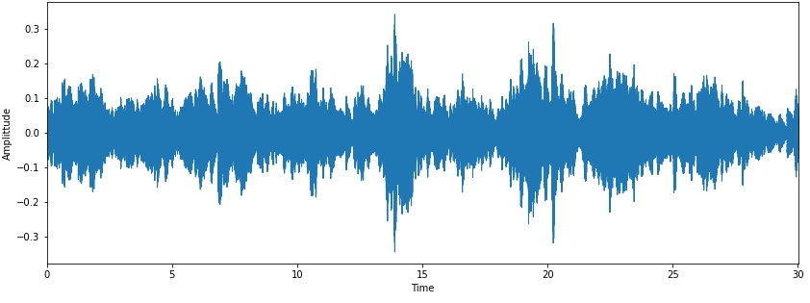
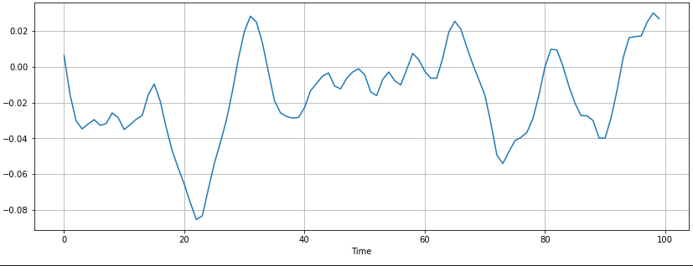
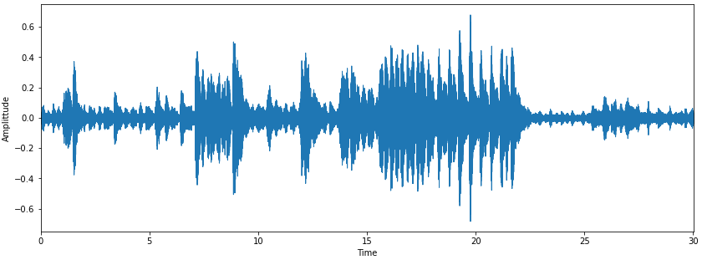
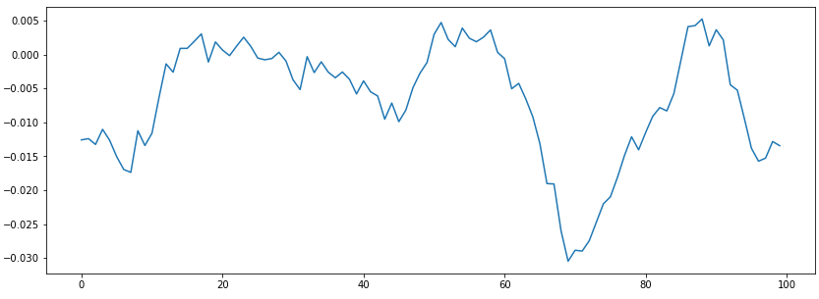
Blues Zero Crossings: 7
Metal Zero Crossings: 19
Classical Zero Crossings: 10
Jazz Zero Crossings: 12

Slide 9
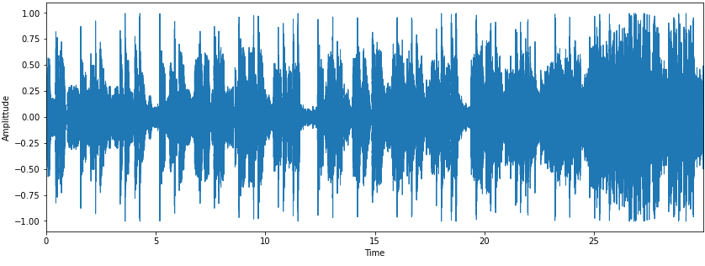
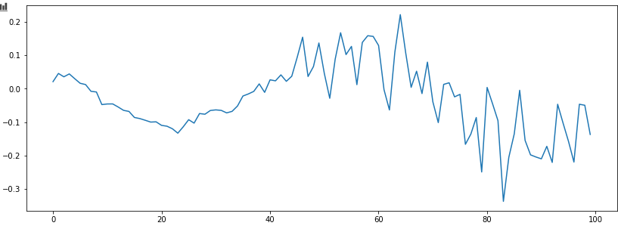
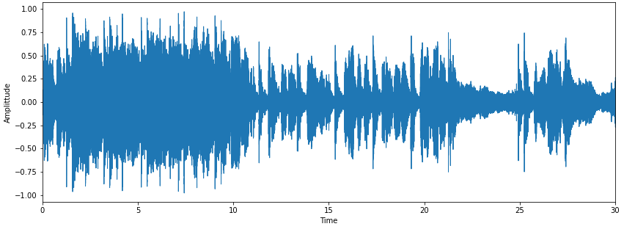
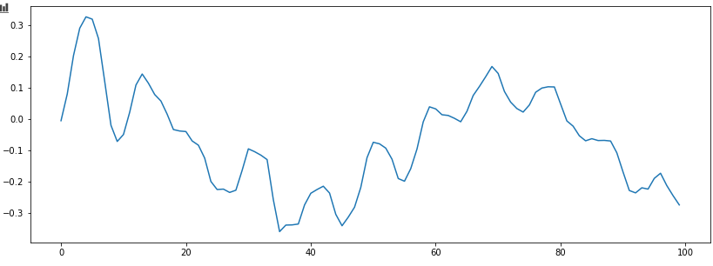
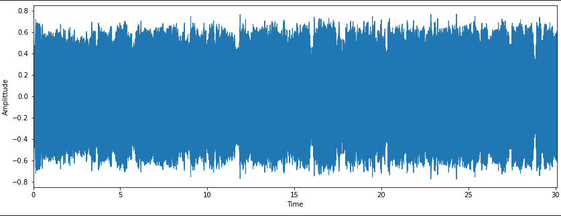
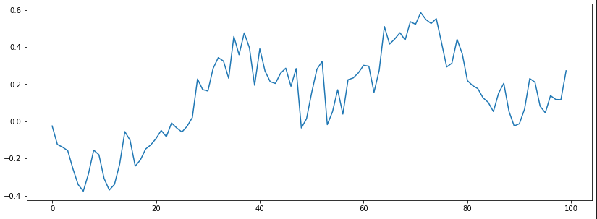
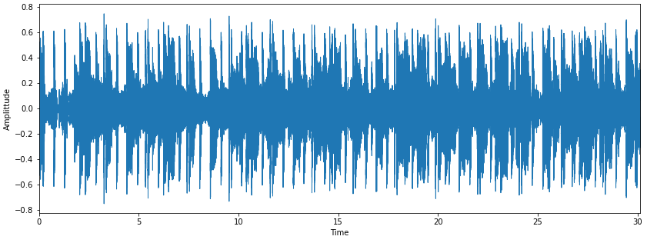
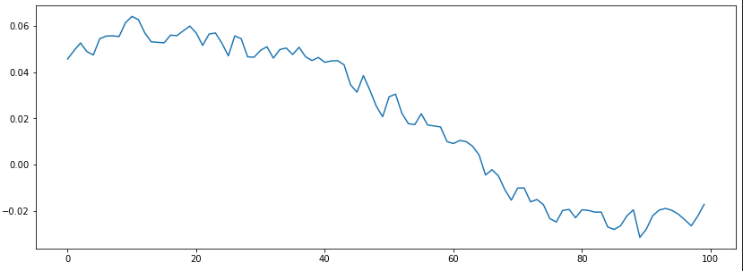
Pop Zero Crossings: 15
Rock Zero Crossings :8
Country Zero Crossings :7
Disco Zero Crossings : 1

Slide 10
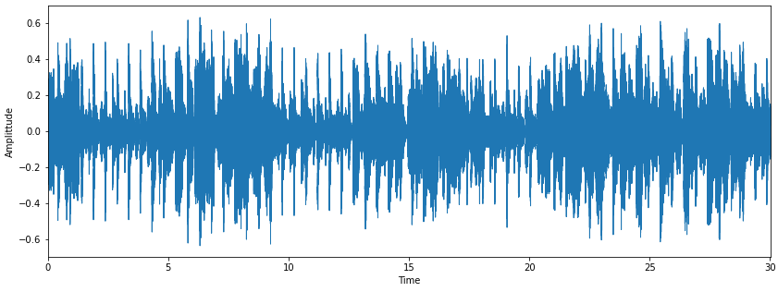
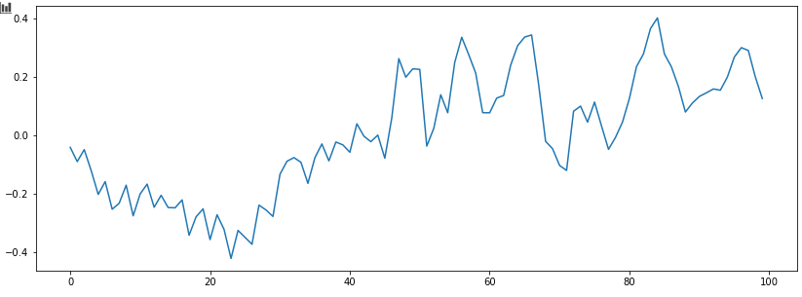
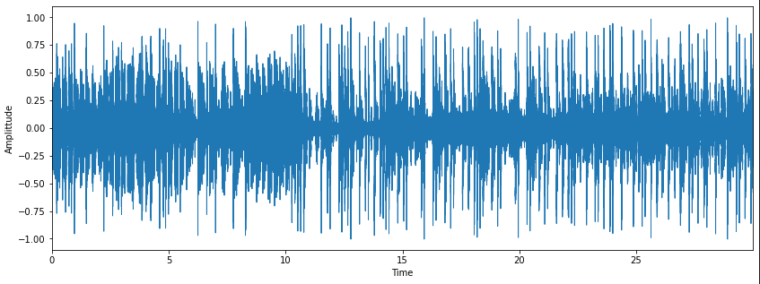
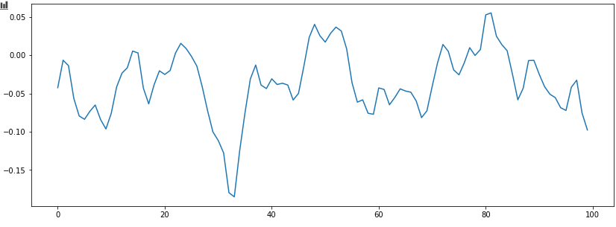
Reggae Zero Crossings:11
Hip Hop Zero Crossings: 12

Slide 11
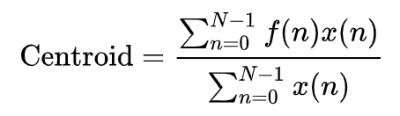
Spectral Centroid
Measure used to characterise a spectrum
Indicates where the „centre of the mass“ for a sound is located
Calculated as the weighted mean of the frequencies present in the sound
x(n) represents the magnitude, f(n) the mean frequency of every interval

Slide 12
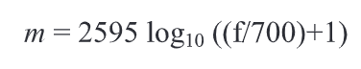
MFCC
Small set of features (20 in our case)
Describe the overall shape of a spectral envelope and models the charasteristics of the human voice
Human perception of speech/sound is linear until 1000 Hz Range(100-3200 Hz) and logarithmic from threre
Conversion from normal frequency f to mel frequency m:

Slide 13
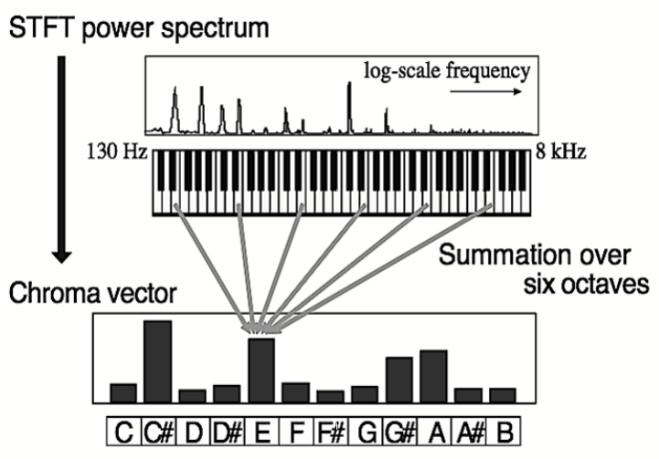
Chroma
Project the whole spectrum onto the 12 distinct semitones (chromas) of the musical octave
Mellina, Alessio & Sentinelli, Alexandro & Marfia, Gustavo & Roccetti, Marco. (2012). AREEB: Automatic REfrain extraction for ThumBnail. 2012 IEEE Consumer Communications and Networking Conference, CCNC'2012. 10.1109/CCNC.2012.6181003.

Slide 14
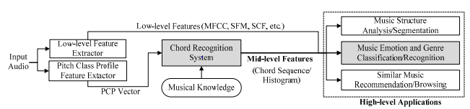
Chord Feature
Taking the Chromagramm and extract the Pitch Class Profile
Calculate the Transition Matrix
Train the Neural Network

Slide 15
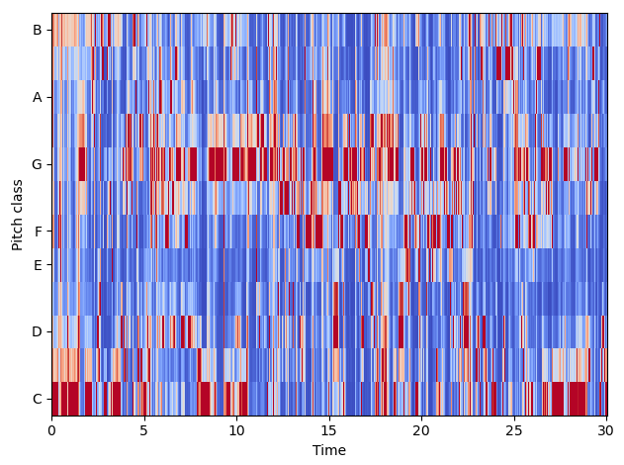
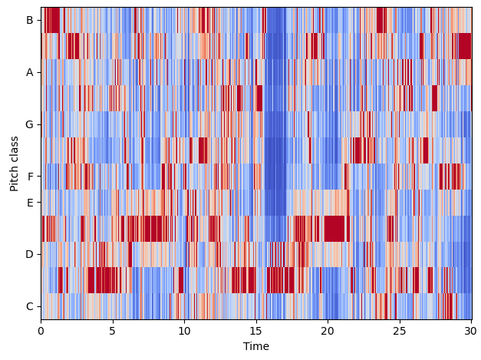
Chord Feature
Chromagrams for blues (left) and metal (right)

Slide 16
Our Classifiers
Logistic Regression:
“One-versus-rest“ scheme, uses a quasi-Newton optimizer with a maximum of 100 iterations
Random Forests:
Averages over multiple Decision Trees, which are only trained on subsets of the available data
Multi-Layer Perceptron:
Supervised Neural Network with tunable size of hidden layers
Uses Backpropagation, and stochastic gradient descent or a quasi-Newton optimizer
Support Vector Machine:
Parameters: c.f. Appendix

Slide 17
Model Selection: MLP
Which Parameters form the model with the highest accuracy? Investigated options included:
hidden_layer_sizes: (100) , (100,50) or (50,50,50)
activation: ‘relu‘ or ‘logistic‘
solver: ‘lbfgs’ (quasi-Newton optimizer) or ’adam’ (based on stochastic gradient descent)
alpha: 0.0001 or 0.01
learning_rate: ‘constant‘, ‘invscaling’ or ‘adaptive’
max_iter: 250 or 500
→ Find the best parameters with a cross-validated grid-search over this parameter grid

Slide 18
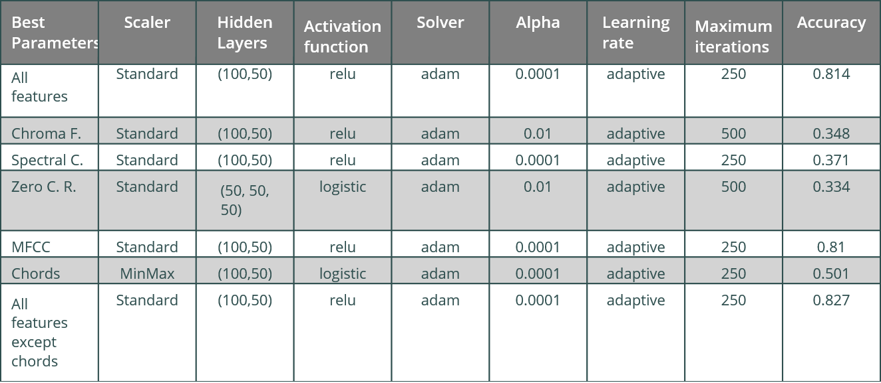
Parameters with highest accuracy

Slide 19
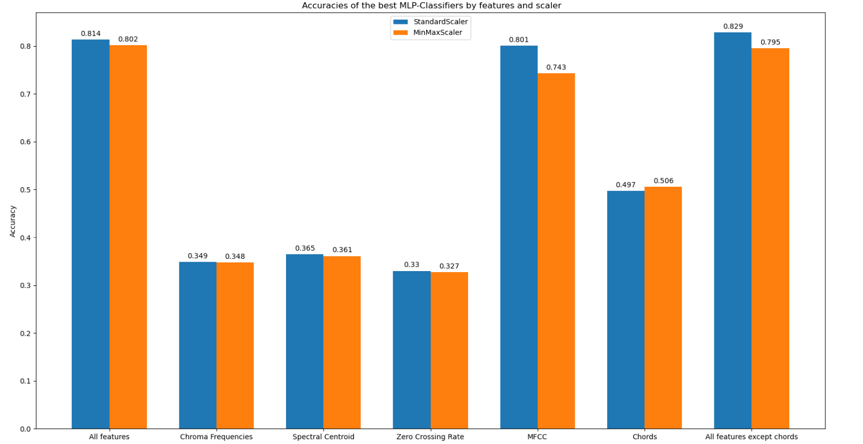
Parameters with highest accuracy

Slide 20
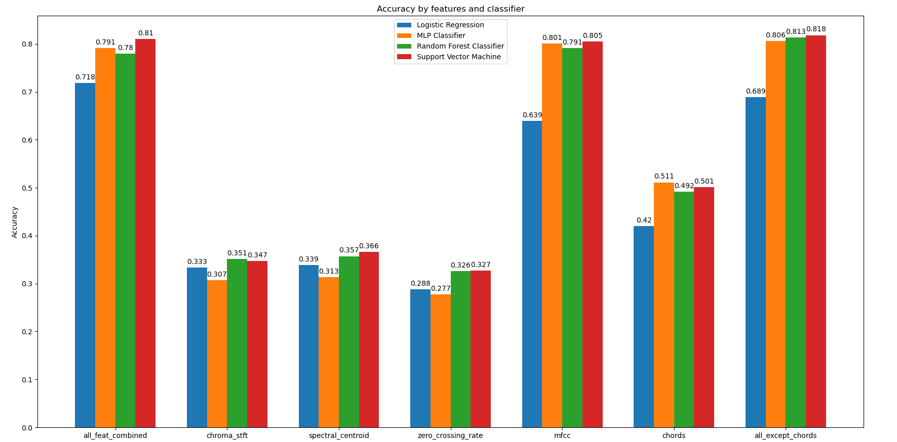
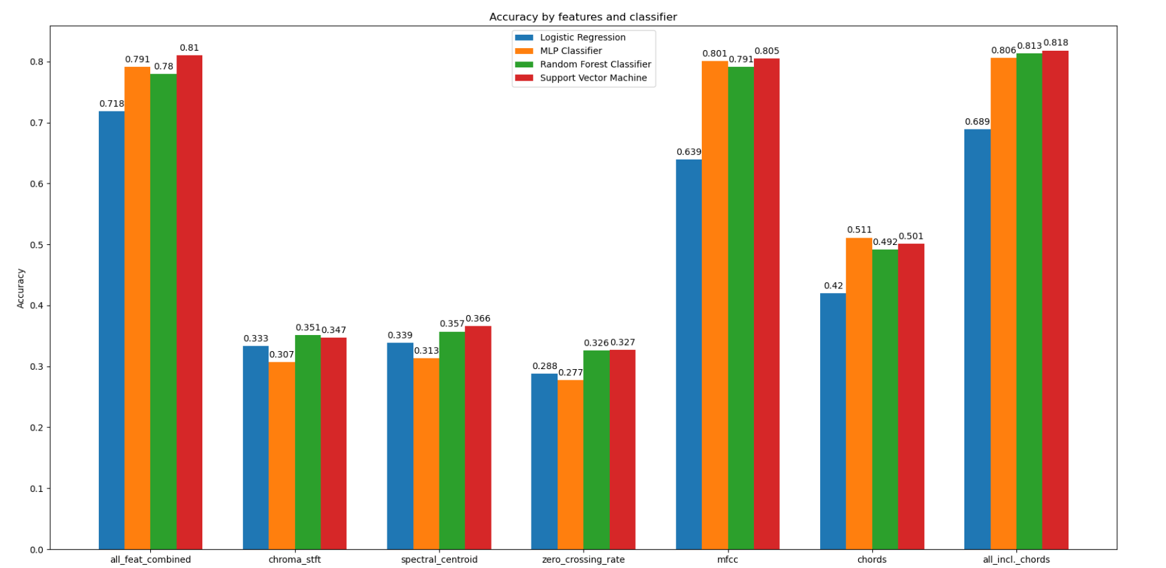
Evaluation: Accuracies

Slide 21
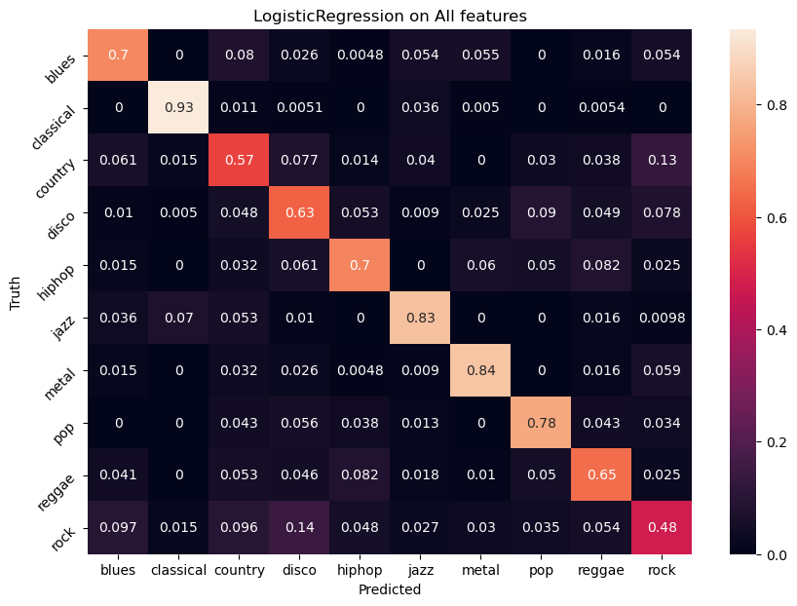
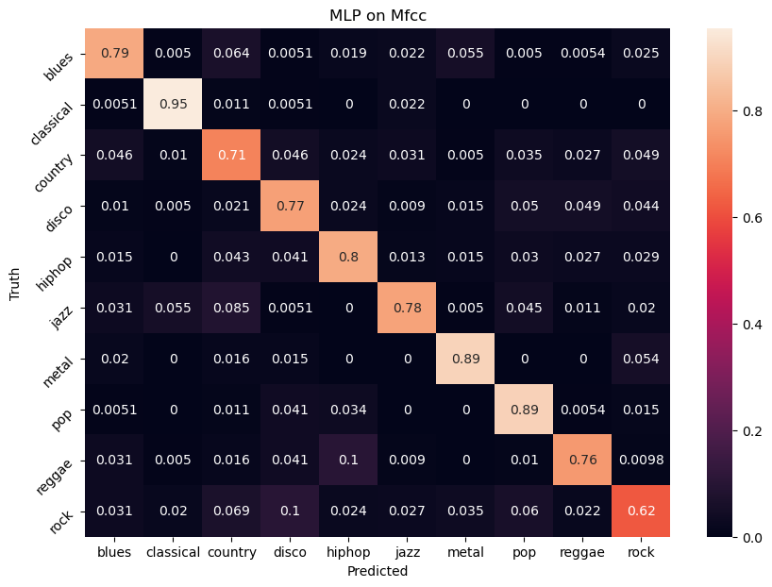
Confusion Matrizes

Slide 22
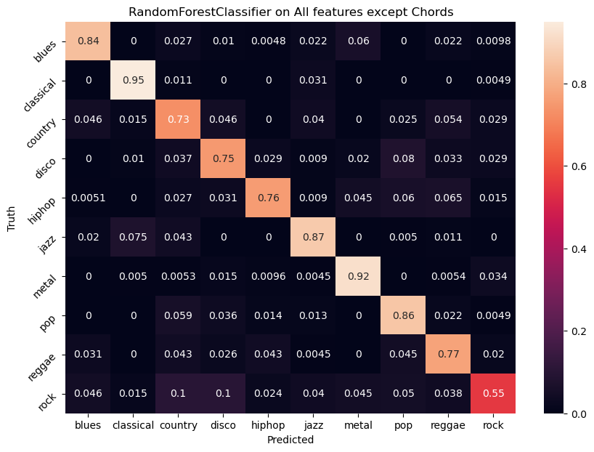
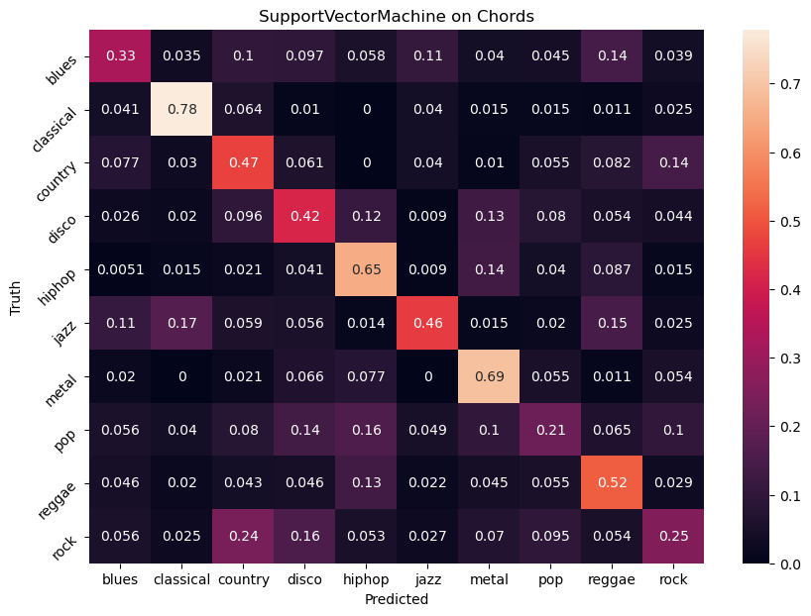
Confusion Matrizes

Slide 23
Ensemble Methods
Reasons why ensemble learning might be better:
Training data might not provide sufficient information for choosing a single best learner
Search process of the learning algorithm for the best Hypthesis might be imperfect
Hypothesis space might not contain the true target function → ensemble could approximate

Slide 24
Ensemble Methods
Bagging:
Serveral samples upto the size of the actual data set are drawn from the data set, where certain elements can be drawn more than once
Boosting:
Weights the dataset after each round of training and increases the weight of each incorrectly classified element
Stacking:
Simply takes the predictions of an ensemble of base learners as an input for another machine learning method

Slide 25
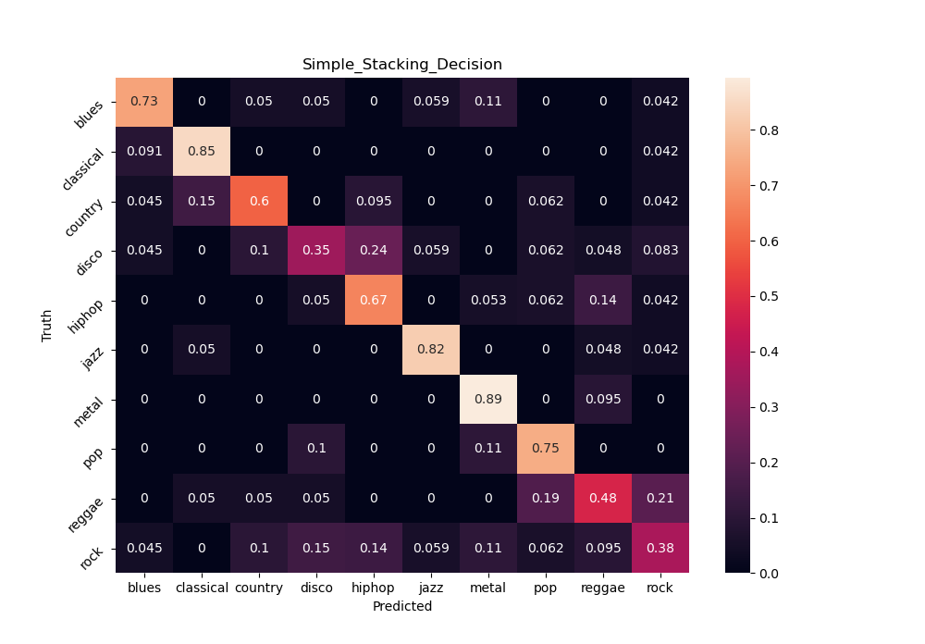
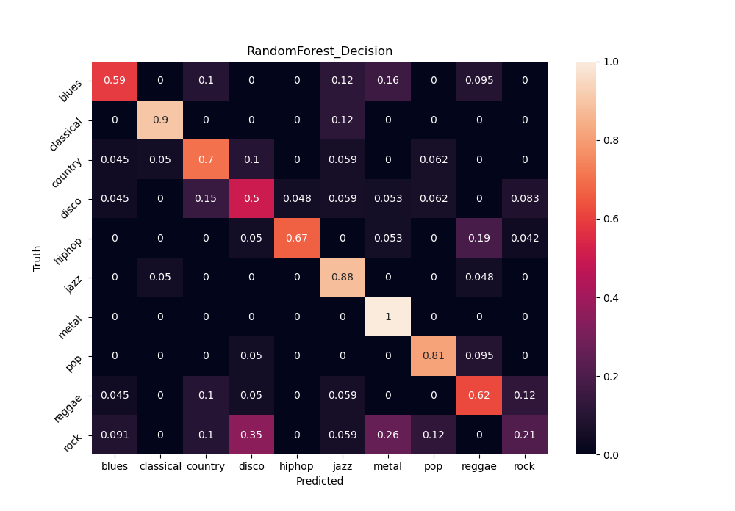
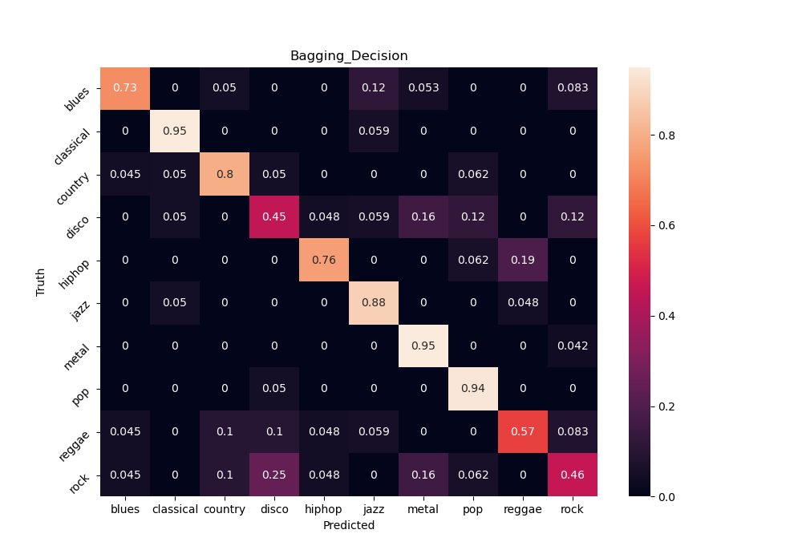
Ensemble Methods
Accuracy: 73,5%
Accuracy: 64%
Accuracy: 67%

Slide 26
Input-Pipeline
Job:
input costum data to be classified
arrange data to be accessible for the feature- and model boxes
Approach:
team needs 1-D numpy array of audio-samples, due to Librosa-specification
therefore, develop routine to read/record audio-files and convert these into required numpy arrays
libraries: pydub (requires: FFMPEG), sounddevice

Slide 27
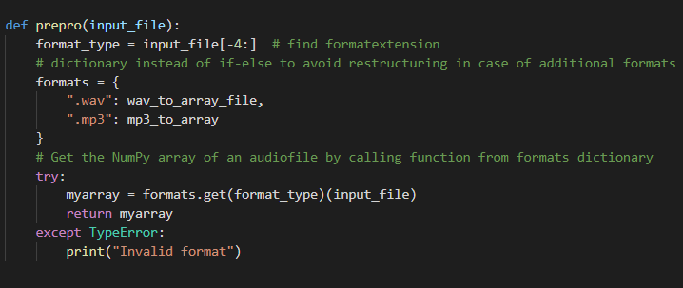
Input-Pipeline
Read & Convert Files:
input: File
master function reads and delegates tasks to appropriate functions
decided for WAV and MP3
use dictionary to make code easily extendable
return: array

Slide 28
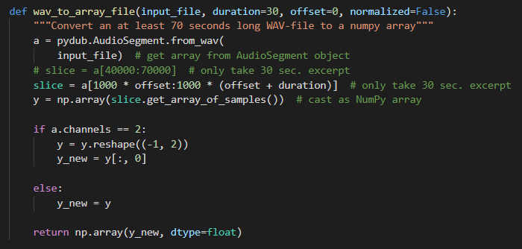
Input-Pipeline
Convert file to array:
input: file
only take 30 seconds of audio , needed for the classifyer
each channel has an independent audio signal, so taking one channel for samples should suffice
return: array

Slide 29
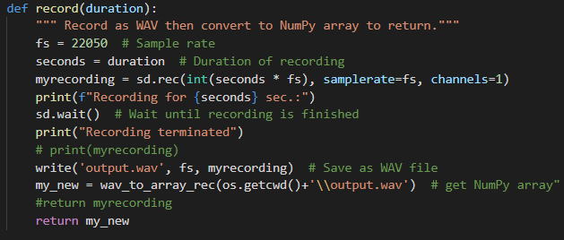
Input-Pipeline
Record:
record for 30 seconds to WAV
technical part outsourced to Sounddevice
convert WAV to array of samples
return: array

Slide 30
Outlook:
Possible next/further steps:
Feature based: extract more features (eg. spectral-rollof), compare standard deviation with variance
Data based: Use 1million songs data set
Model based: scale with sklearn.Normalizer, cross-validated grid-search for all Classifiers
Train a Neural Network with only the images of the Spectograms
Evaluate effects of different input formats
GUI?

Slide 31
References 1/2
https://www.kaggle.com/andradaolteanu/gtzan-dataset-music-genre-classification/data ; free available dataset
https://towardsdatascience.com/music-genre-classification-with-python-c714d032f0d8
Valerio Velardo - The Sound of AI (YouTube Channel)
https://towardsdatascience.com/musical-genre-classification-with-convolutional-neural-networks-ff04f9601a74
MSc Computer Science, University of Birmingham,‘‘Machine Learning for Music Genre Classification‘‘, Author: Bryn Lansdown, Supervisor: Dr. Shan He
https://www.youtube.com/watch?v=t0mNFAFdz_Q&t=267s Caio Miyashiro at Pydata Berlin 2019 about Chord Recognition
Cheng, Heng-Tze & Yang, yi-hsuan & Lin, Yu-Ching & Liao, I-Bin & Chen, Homer. (2008). Automatic chord recognition for music classification and retrieval. 1505 - 1508. 10.1109/ICME.2008.4607732.

Slide 32
References 2/2
Mellina, Alessio & Sentinelli, Alexandro & Marfia, Gustavo & Roccetti, Marco. (2012). AREEB: Automatic REfrain extraction for ThumBnail. 2012 IEEE Consumer Communications and Networking Conference, CCNC'2012. 10.1109/CCNC.2012.6181003.
https://musicinformationretrieval.com/stft.html
Trevor Hastie, Robert Tibshirani, Jerome Friedman, "The Elements of Statistical Learning - Data Mining, Inference and Prediction", Second Edition, Springer Series in Statistics, Springer, 2008
https://scikit-learn.org/stable/modules/ensemble.html
https://realpython.com/playing-and-recording-sound-python/
https://github.com/jiaaro/pydub/
https://ffmpeg.org/

Slide 33
Task Distribution
All team members: Find literature, pappers and investigate different approaches od the problem from multiple, open to the public sources
Dennis: Project Management, merge and control the Project Plan, part of feature extraction especially chord feature
Stella: Find dataset, Explore features needed to be extracted (coll. with Dennis, Joshua), Feature extraction from dataset and store in a csv file (coll. with Joshua), Import confusion matrices(coll. with Florian)
Joshua: Feature Extraction, Model Selection, Model Evaluation
Florian: Coding Manager, designed overall structure of the code and supported people during implementation, implementation of ensemble learners
Claas: design, implemenation and testing of input-box

Slide 34
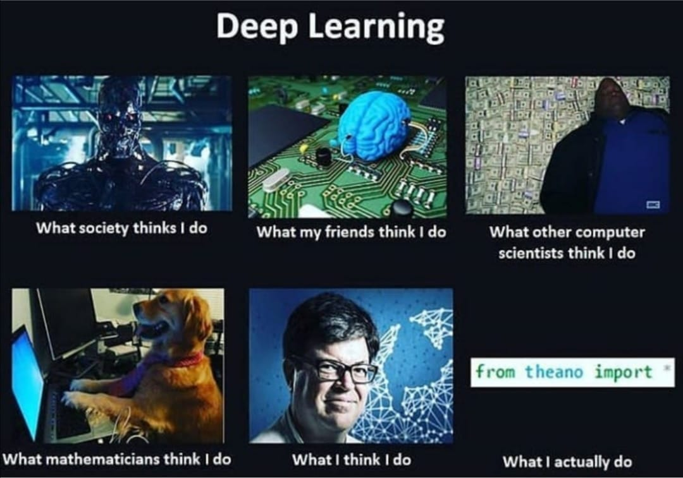


Slide 35
Appendix

Slide 36
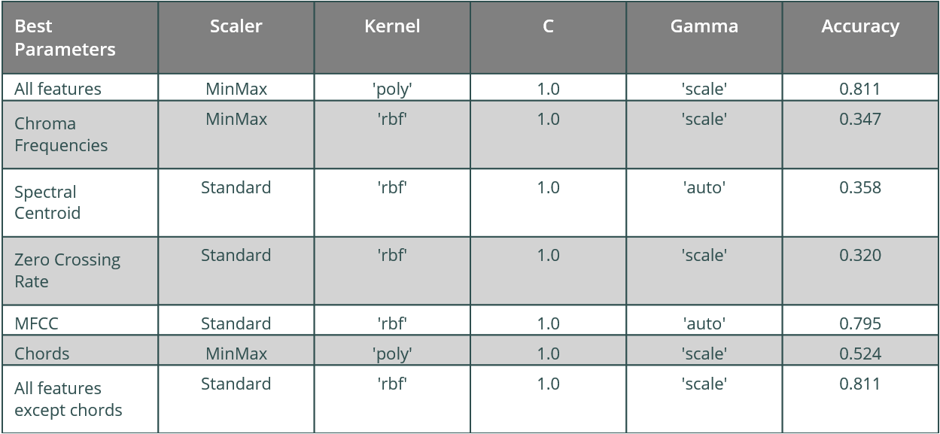
Model Selection: SVM

Slide 37
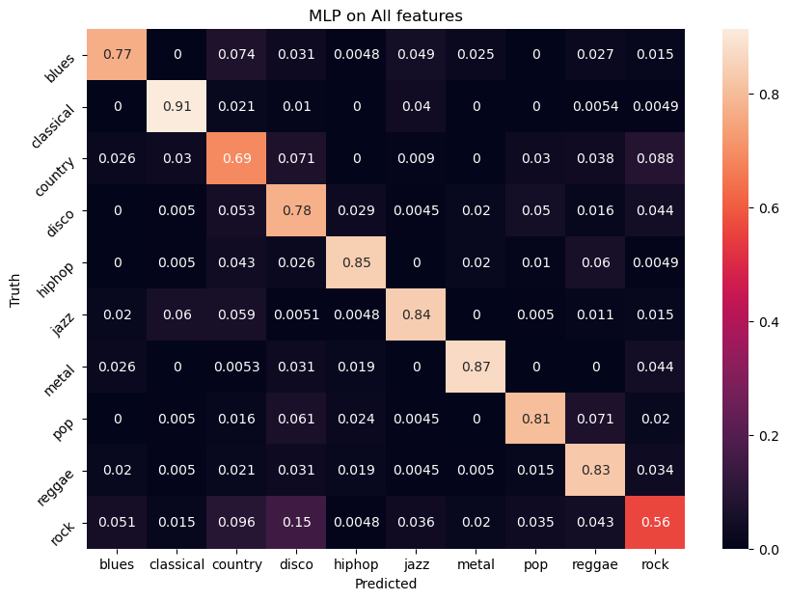
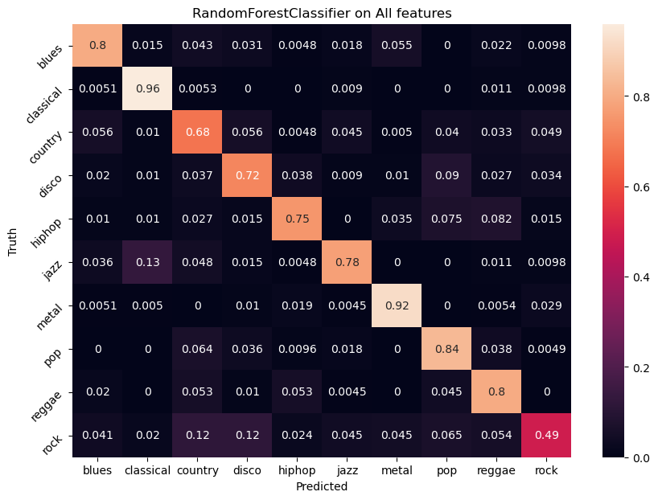
More Confusion Matrizes

Slide 38
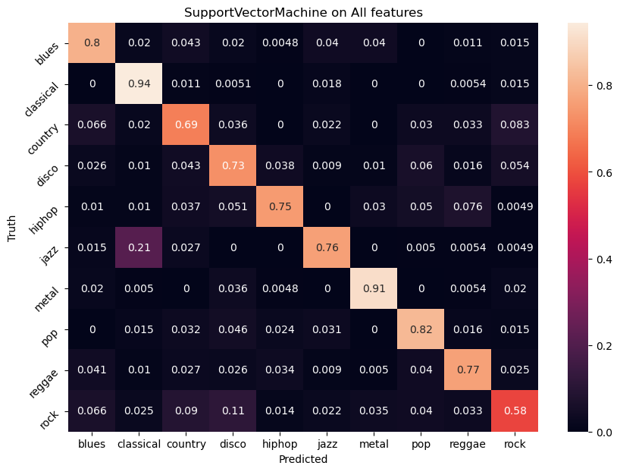

More Confusion Matrizes

Slide 39
Code
You can find the code at:
https://github.com/MrGandalv/MUGGE

